Slide 1

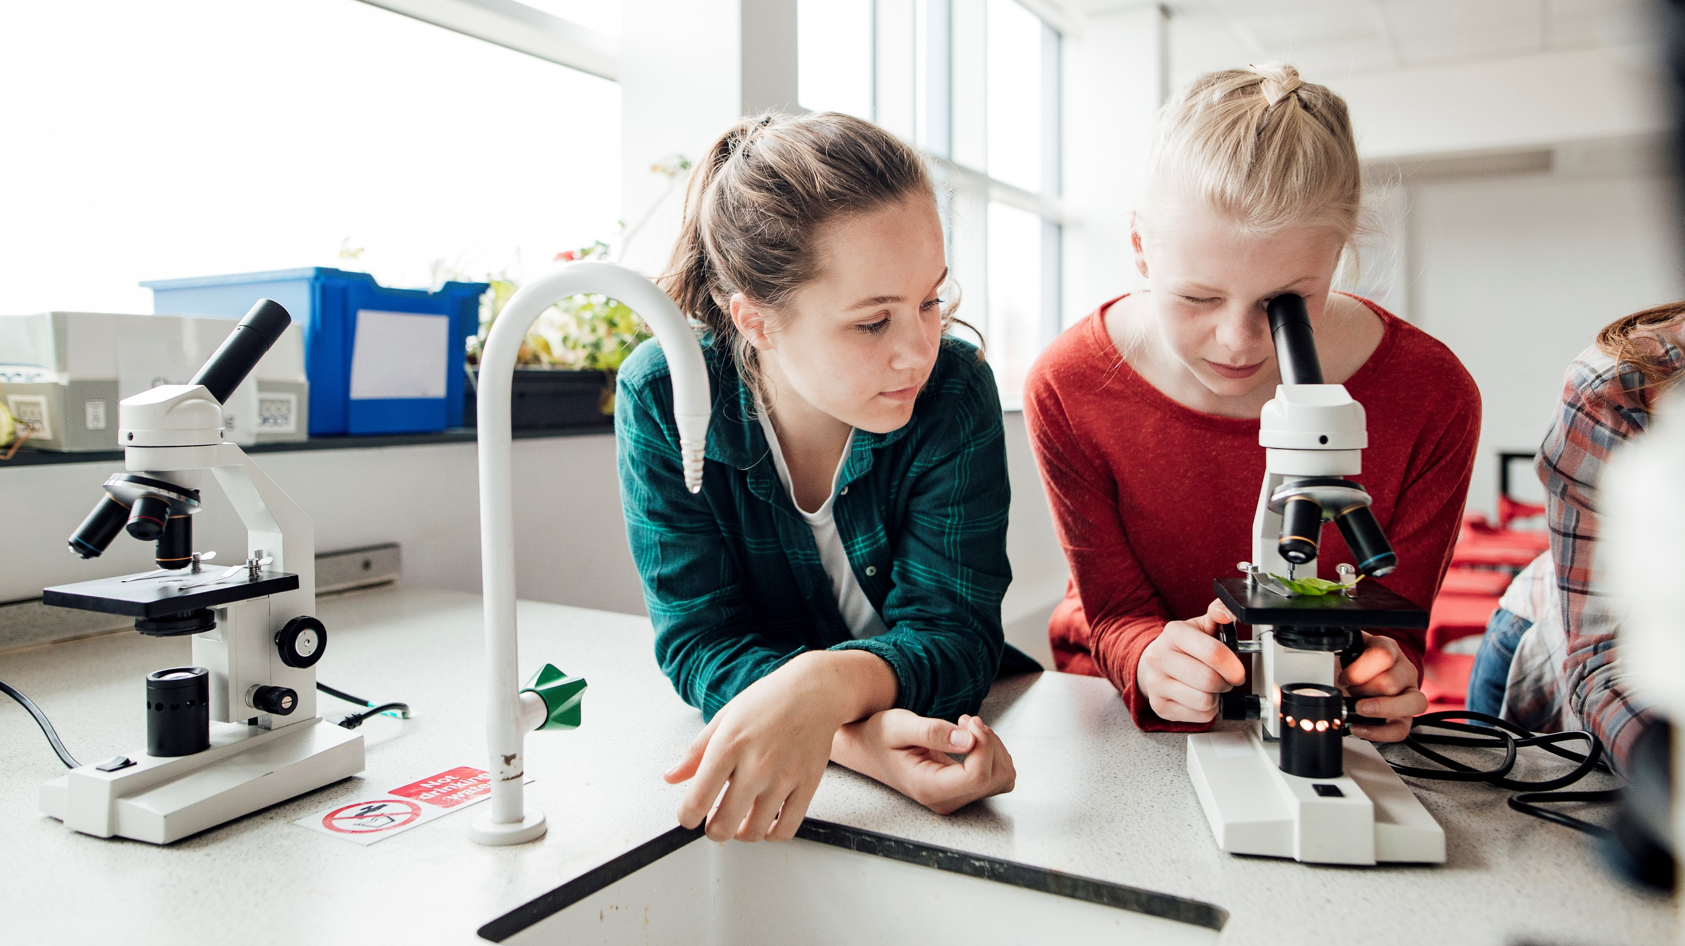
Car license plate recognition based on CNN

Slide 2
contents
Abstract
Introduction of CNN
Code analyze
Summary and prospect
Reference
Introduction of the system
Study background
Installation and environment

Slide 3
Abstract
This system implements a car plate recognition system, which consists of car plate location, character recognition, and convolution neural network training and recognition module.
Experimental results show that compared with other single function methods like OpenCV template image recognition, the CNN method can reach a higher accuracy and lower loss rate.

Slide 4
Study background
License plate recognition mainly includes license plate location, character segmentation, and recognition of character. In the residential district vehicle access management, the expressway toll the car license plate recognition has been widely used.
As a core component, Automatic License Plate Recognition (ALPR) plays an important role in modern Intelligent Transportation System (ITS). Due to the complexity in real world, many existing license plate detection and recognition approaches are not robust and efficient enough for practical applications, therefore ALPR still a challenging task both for engineers and researchers.

Slide 5
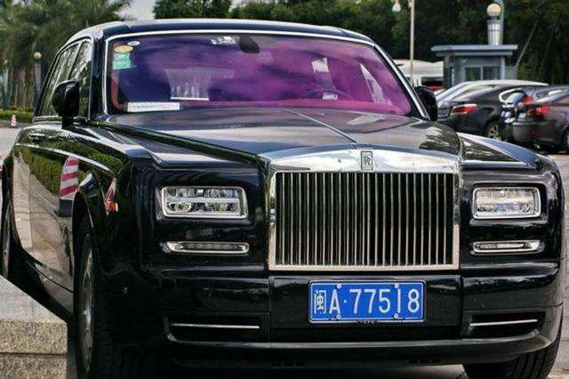
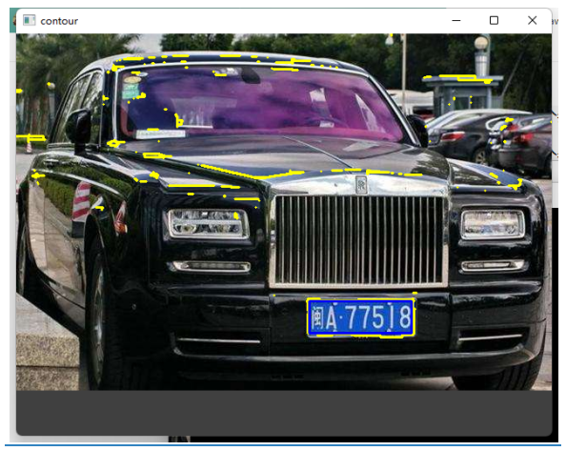
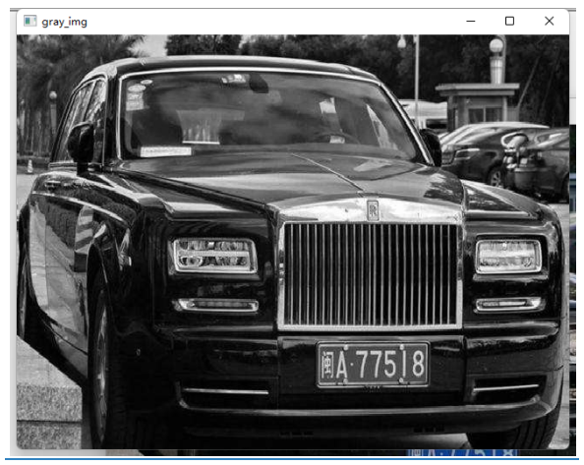
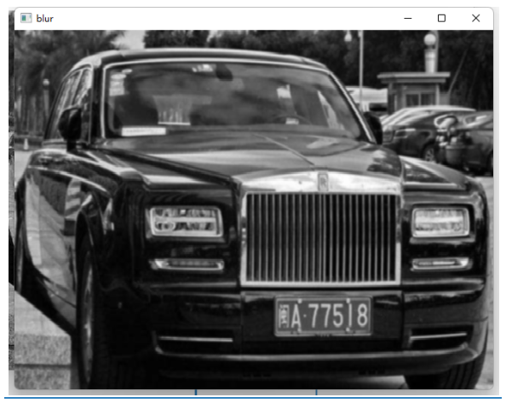
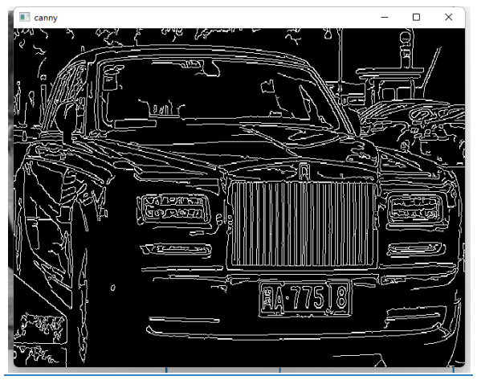
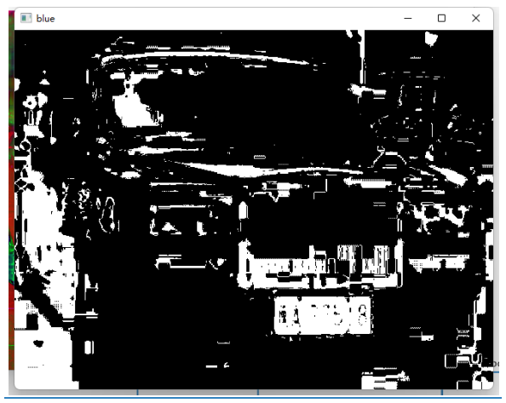
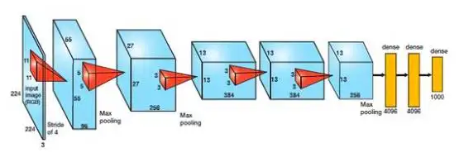
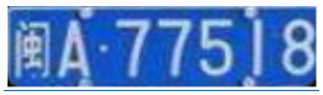

Introduction of the system
Towards End-to-End car license plate detection and recognition using CNN
Input image
(RGB, high resolution)
Image processing car plate locating using openCV
Gray scale
blur
Find edge
Find area
Recognition by CNN network
Crop the car plate
Output

Slide 6
Introduction of the system
Towards End-to-End car license plate detection and recognition using CNN
This is a car plate recognition core system. It includes the core function of car plate recognition but does not include the application like user interface, package distribution and installation, and hardware utilization.
We need to train the model for car plate and character recognition separately. The training dataset can fetch from CCPD (Chinese City Parking Dataset, ECCV).
Once the model is trained. We then can start to identify car plates. We just move the image to the specific directory, run the identification program and it will print out the identification result.
This system succinctly takes license plate detection and recognition as two associated parts and is trained end-to-end.

Slide 7
Installation and environment
For DEMOSTRATION
Move the image into the directory ./images/pictures/
Run python carlPlateIdentity.py {image name}
For training
Run python charNeuralNet.py 0
Run python plateNeuralNet.py 0
For testing
Run python charNeuralNet.py 1
Run python plateNeuralNet.py 1
Environment
OpenCV
TensorFlow
Python 3.8
Numpy

Slide 8
INTRODUCTION OF CNN
In deep learning, a convolutional neural network (CNN, or ConvNet) is a class of artificial neural network (ANN), most applied to analyze visual imagery.
It based on the shared-weight architecture of the convolution kernels or filters that slide along input features and provide translation-equivariant responses known as feature maps.
CNNs are regularized versions of multilayer perceptrons. Multilayer perceptrons usually mean fully connected networks, that is, each neuron in one layer is connected to all neurons in the next layer.
Convolutional networks were inspired by biological processes in that the connectivity pattern between neurons resembles the organization of the animal visual cortex.
Individual cortical neurons respond to stimuli only in a restricted region of the visual field known as the receptive field. The receptive fields of different neurons partially overlap such that they cover the entire visual field.

Slide 9
Principles OF CNN
A typical CNN consists of 3 parts: Convolution layer, Pooling layer and Fully connected layer
The convolutional layer is responsible for extracting local features in the image; the pooling layer is used to significantly reduce the parameter magnitude; the fully connected layer is similar to the traditional neural network portion and is used to output the desired result.

Slide 10
Convolution - extraction features
The operation of the convolutional layer is as shown in the figure, using a convolution kernel to scan the entire picture:
This process we can understand is that we use a filter (convolution kernel) to filter the small areas of the image to get the eigenvalues ​​of these small areas.
After passing through a convolutional layer, the image becomes abstracted to a feature map, also called an activation map, with shape: (number of inputs) x (feature map height) x (feature map width) x (feature map channels).

Slide 11
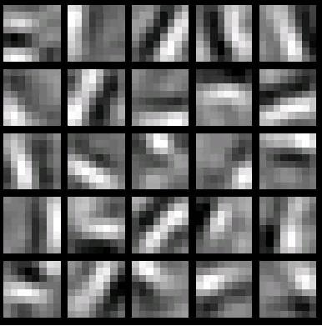
Convolution - extraction features
In a specific application, there are often multiple convolution kernels. It can be considered that each convolution kernel represents an image mode. If an image block is convolved with the convolution kernel, the image block is considered to be Very close to this convolution kernel. If we design 6 convolution kernels, we can understand that we think there are 6 underlying texture patterns on this image, that is, we can draw an image using the basic mode in 6. The following are examples of 25 different convolution kernels:

Slide 12
Pooling - dimensionality reduction
The pooling layer is simply a down sampling, which can greatly reduce the dimensions of the data. The process is as follows
The reason for this is that even after the convolution is done, the image is still large (because the convolution kernel is small), so in order to reduce the data dimension, the downsampling is performed.

Slide 13
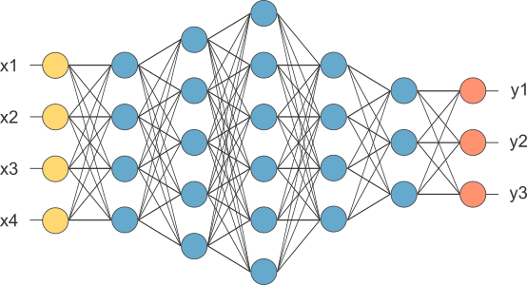
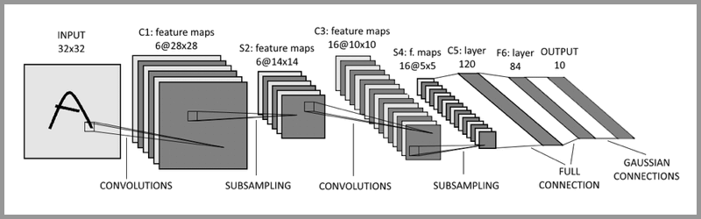
Fully connected layer - Classification
Fully connected layers connect every neuron in one layer to every neuron in another layer. It is the same as a traditional multilayer perceptron neural network (MLP). The flattened matrix goes through a fully connected layer to classify the images.
A typical CNN is not just the 3-layer structure mentioned above, but a multi-layer structure, such as the structure of LeNet-5

Slide 14
Code analyze
Data set
Training
Testing
Preprocessing
Locating
recognition

Slide 15
Repository address – https://github.com/XIAOCHONG-LIN/CarPlateRecognizationCNN
carPlateIdentity.py – the main module for identify the car plate
charNeuralNet.py – the training module for identify the character of car plate
plateNeuralNet.py – the training module for identify the car plate image
carIdentityData – the training dataset category
Images – the identification module image category

Slide 16
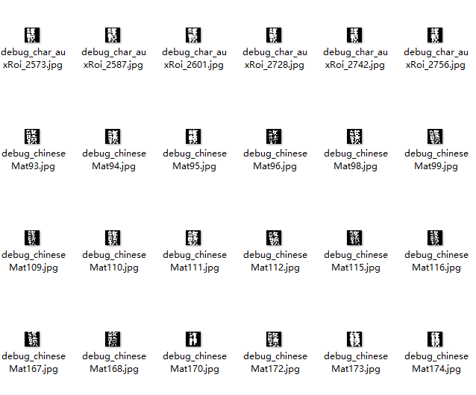
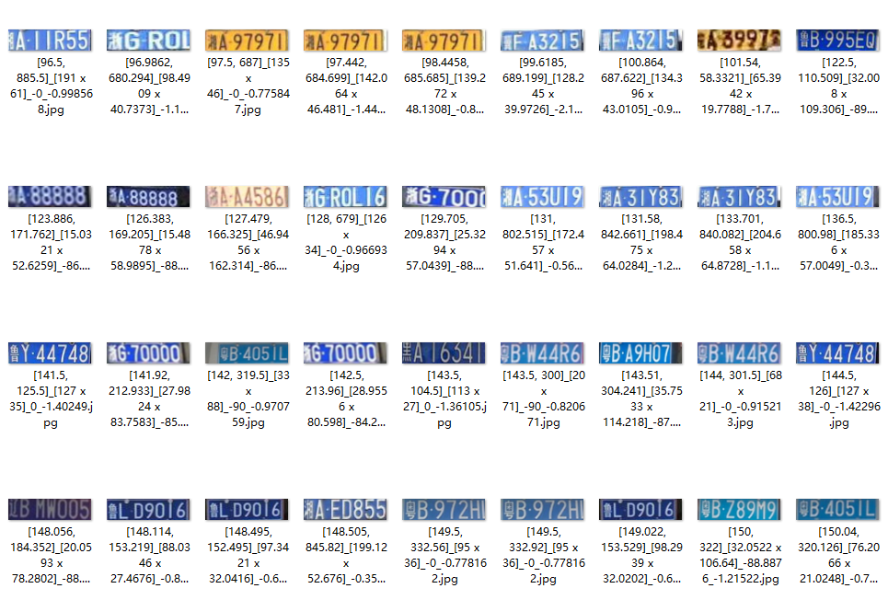
Code analysis – data set
We use CCPD (Chinese City Parking Dataset, ECCV) as the training and testing dataset.
Dataset includes five directories
Character training dataset
Character testing dataset
Car plate training dataset
Car plate testing dataset
The model is stored in ‘model’ sub directory.

Slide 17
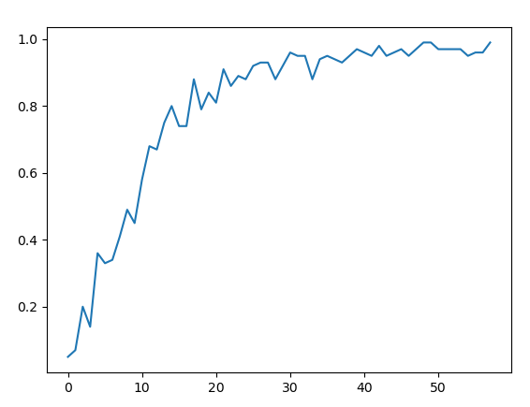
Code analysis Training – character
Initial data
Split the train data and test data
Construct CNN layers
Soft max normalization
Set the rule of accuracy calculation
Set the rule of the cost calculation
Set the train step
Start training
in around 500 steps, the accuracy converges to higher than 99%

Slide 18
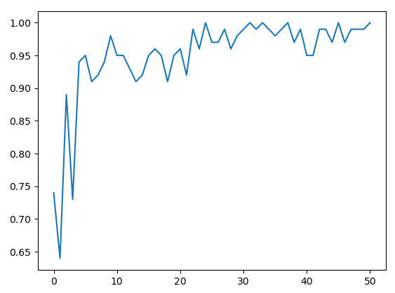
Code analysis Training – car plate
Initial data
Split the train data and test data
Construct CNN layers
Soft max normalization
Set the rule of accuracy calculation
Set the rule of the cost calculation
Set the train step
Start training
in around 250 steps, the accuracy converges to higher than 99%

Slide 19
Code analysis testing – character
Initial data
Construct cnn layers
Softmax normalization
Set the predicted axis
Start testing
total: 549 incorrect: 26
Accuracy rate: 0.9526411657559198

Slide 20
Code analysis testing – car plate
Initial data
Construct cnn layers
Softmax normalization
Set the predicted axis
Start testing
total: 200
incorrect: 62 0.6388506
incorrect: 77 0.72059715
incorrect: 147 0.83242637
contains car plate:98, no car plate:99
Accuracy rate: 0.985

Slide 21
Code analysis – processing image
Convert to grayscale
gray_img = cv2.cvtColor(orig_img, cv2.COLOR_BGR2GRAY)

Slide 22
Code analysis – processing image
Gaussian blue
kernel size 5
kernel_size = 5 gauss_gray = gaussian_blur(gray_img, kernel_size)

Slide 23
Code analysis – processing image
Canny edge finding
low threshold = 50
Hight threshold = 150
low_threshold = 50 high_threshold = 150 canny_edges = canny(gauss_gray, low_threshold, high_threshold)

Slide 24
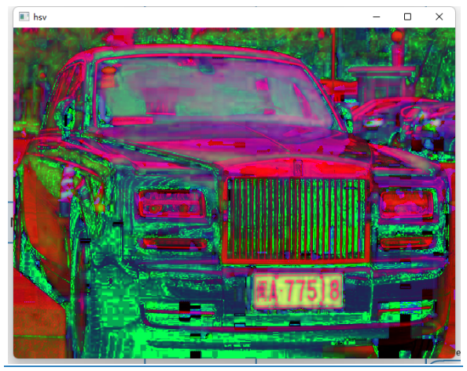
Code analysis – processing image
Convert to hsv image to get h, s, v data
hsv_img = cv2.cvtColor(orig_img, cv2.COLOR_BGR2HSV) h, s, v = hsv_img[:, :, 0], hsv_img[:, :, 1], hsv_img[:, :, 2]

Slide 25
Code analysis – processing image
Find blue area
Range between 100, 124
blue_img = (((h > 26) & (h < 34)) | ((h > 100) & (h < 124))) & (s > 70) & (v > 70) blue_img = blue_img.astype('float32')

Slide 26
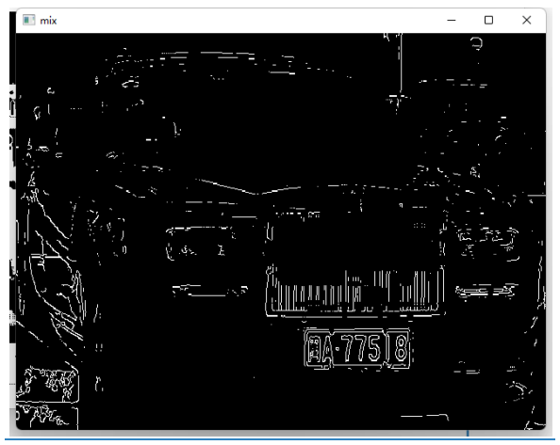
Code analysis – processing image
Find the blue edge
mix_img = np.multiply(canny_edges, blue_img)

Slide 27
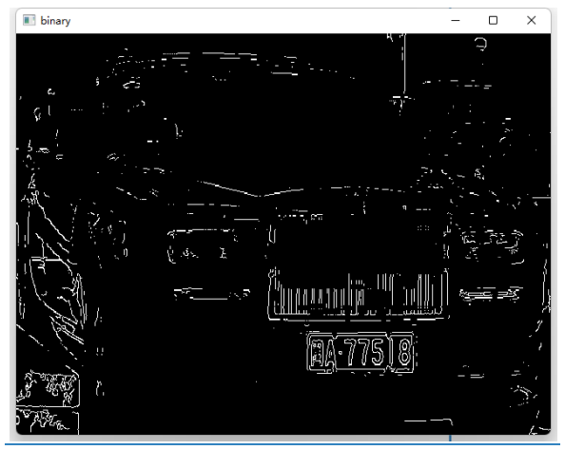
Code analysis – processing image
Binarization
ret1, binary_img = cv2.threshold(mix_img, 0, 255, cv2.THRESH_BINARY | cv2.THRESH_OTSU)

Slide 28
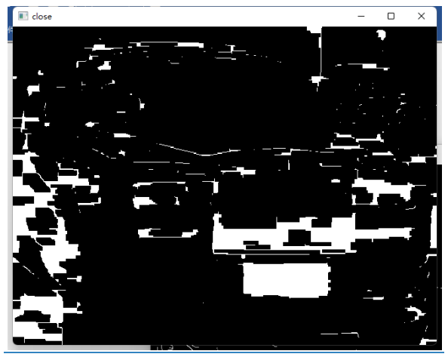
Code analysis – processing image
Morphology
kernel = cv2.getStructuringElement(cv2.MORPH_RECT, (21, 5)) close_img = cv2.morphologyEx(binary_img, cv2.MORPH_CLOSE, kernel)

Slide 29
Code analysis – locate car plate
Find contours
contours, hierarchy = cv2.findContours(pred_image, cv2.RETR_EXTERNAL, cv2.CHAIN_APPROX_SIMPLE)

Slide 30
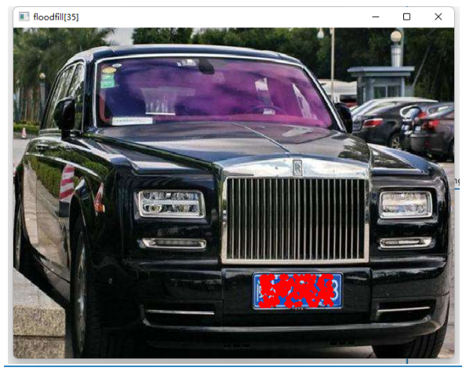
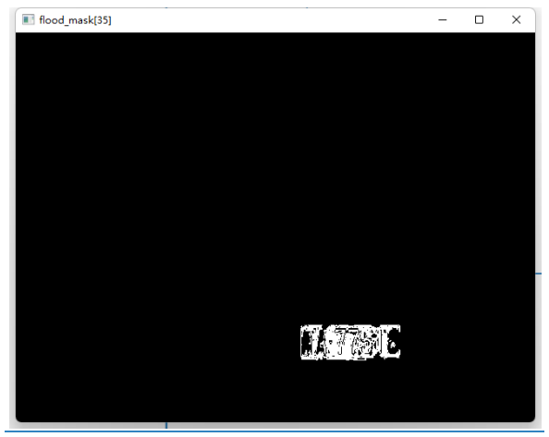
Code analysis – locate car plate
Flitter the possible rectangle
Find the mini area rectangle
Verify car plate by scale
Verify car plate by color
Find the column range and row range
Adjust the angle of the rectangle
Flood fill the area
Get the mask area
Transform the image if there is an angel
Adjust the size for CNN recognition

Slide 31
Code analysis – cnn building
build three convolution and pooling layers
cw1 = tf.Variable(tf.random_normal(shape=[3, 3, 1, 32], stddev=0.01), dtype=tf.float32) cb1 = tf.Variable(tf.random_normal(shape=[32]), dtype=tf.float32) conv1 = tf.nn.relu(tf.nn.bias_add(tf.nn.conv2d(x_input, filter=cw1, strides=[1, 1, 1, 1], padding='SAME'), cb1)) conv1 = tf.nn.max_pool(conv1, ksize=[1, 2, 2, 1], strides=[1, 2, 2, 1], padding='SAME') conv1 = tf.nn.dropout(conv1, self.keep_place)
build three fully connection layers
fw1 = tf.Variable(tf.random_normal(shape=[3 * 3 * 128, 1024], stddev=0.01), dtype=tf.float32) fb1 = tf.Variable(tf.random_normal(shape=[1024]), dtype=tf.float32) fully1 = tf.nn.relu(tf.add(tf.matmul(conv_out, fw1), fb1)) fully1 = tf.nn.dropout(fully1, self.keep_place)

Slide 32
Code analysis – car plate recognition
Recognition of car plate
result index: 0 result probability: 0.9999999
Extract character
recognize character
horizontal projection
filter the one that exceeds the limit
project to Y to get the continuous length
get the total projection length
get the biggest length projection
cut into a single character

Slide 33
SUMMARY AND PROSPECT
This system is still trivial comparing the current car license plate recognition system. It just runs a basic functional module for recognize the car plate. But it covers the main idea of the recognition system.
With more complicate environment such as the image is distorted by light, environment color, angle of car license plate, etc. this system will reduce the accuracy.
There is a technology named lightweight CCN DSNET exist in paper https://link.springer.com/chapter/10.1007/978-3-030-60639-8_25 which could be the next study direction to improve the accuracy in complicate environment.

Slide 34
reference
https://blog.csdn.net/jmh1996/article/details/88951797
https://en.wikipedia.org/wiki/Convolutional_neural_network
https://en.wikipedia.org/wiki/TensorFlow
https://easyai.tech/en/ai-definition/cnn/
SLPNet: Towards End-to-End Car License Plate Detection and Recognition Using Lightweight CNN https://link.springer.com/chapter/10.1007/978-3-030-60639-8_25

Slide 35
THANK YOU!
XIAOCHONG LIN
CS584 spring 2022 project presentation

